Slide 1
Route Searching Algorithm
- BFS(Dijkstra): Breadth-first search
- D-BFS: Double direction Breadth-first search
- DFS: Breadth-first search
- AStar: widely used in pathfinding and graph traversal.
g : the cost of moving from the initial cell to the current cell. Basically, it is the sum of all the cells that have been visited since leaving the first cell.
h : also known as the heuristic value, it is the estimated cost of moving from the current cell to the final cell. The actual cost cannot be calculated until the final cell is reached. Hence, h is the estimated cost. We must make sure that there is never an over estimation of the cost.
f : it is the sum of g and h. So, f = g + h
如果 h(n)<d(n) ，搜索的点数多，搜索范围大，效率低，但能得到最优解。
如果 h(n)=d(n) ，即估计距离 h(n) 等于最短距离，那么搜索将严格沿着最短路径进行，此时的搜索效率是最高的。
如果 h(n)>d(n) ，搜索的点数少，搜索范围小，效率高，但不能保证得到最优解。

Slide 2
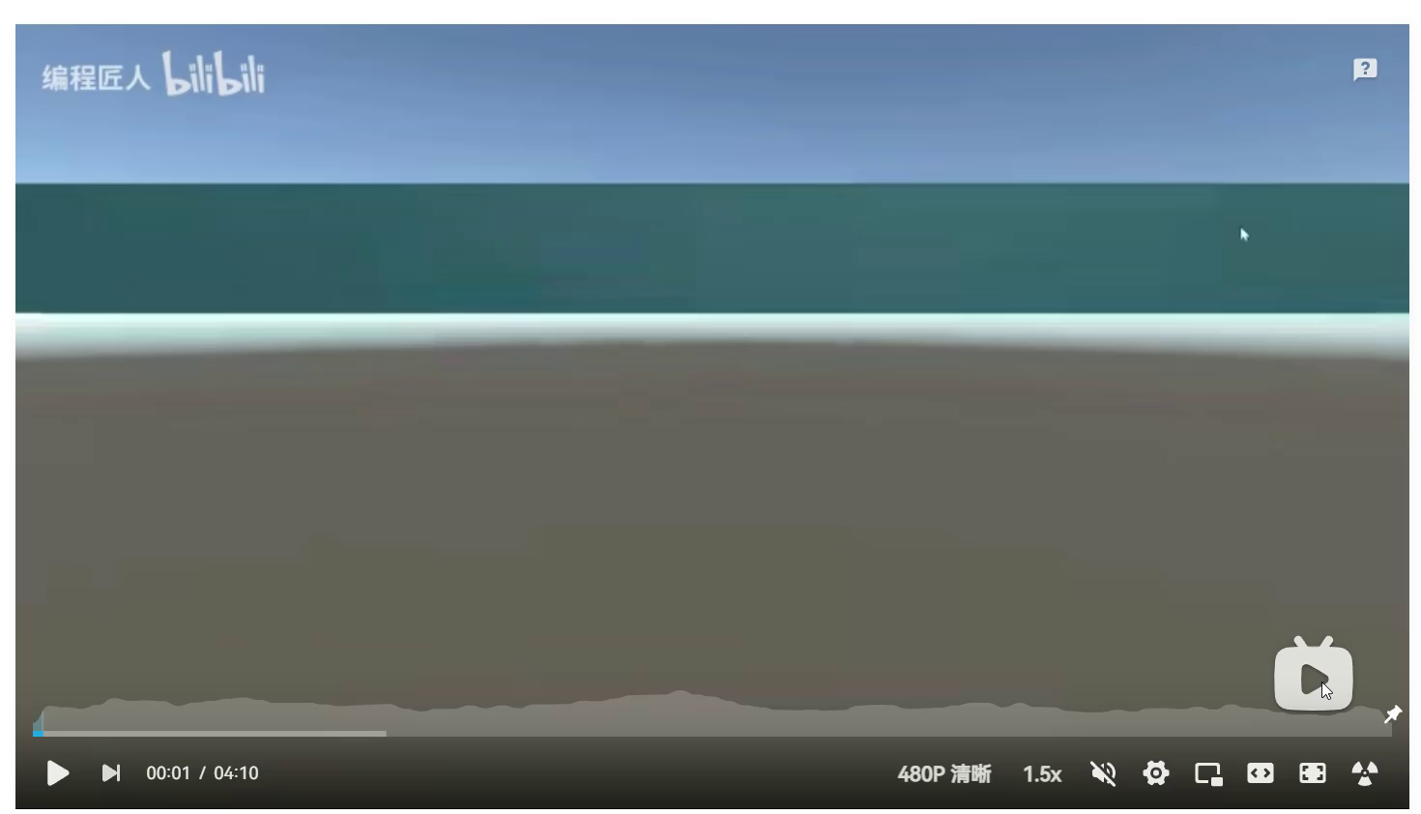
https://www.redblobgames.com/pathfinding/a-star/introduction.html
https://www.redblobgames.com/pathfinding/a-star/implementation.html

